Slide 1
Java 4 WEB
Lesson 2 - Built-In Classes

Slide 2
Lesson goals
java.lang.**
java.util.**
Casting and checking types-of
System info
Optional

Slide 3
java.lang package
Object
String
Wrapper Clases
Math
System
Runtime
Throwable/Exception/Error
…

Slide 4
java.lang.Object
In Java, "almost" all data are objects and inherit Object.
boolean equals (Object);
int hashCode ();
String toString ();
…
Notes:
The "basic" methods of the Object class

Slide 5
java.lang.String
String is a container for 16-bit Unicode characters.
All string literals in Java (for example, "abc") are objects of the String class.
Definition:
String str;
Create:
str = new String () ; str = new String ("hi") ; str = "hi" ; str = "hi" + "there";
Notes:
Stored in byte[] value since java 9
String pool

Slide 6
java.lang.String
int length(); boolean isEmpty();
boolean isBlank(); boolean equals(Object anObject); boolean startsWith(String prefix); int indexOf(int ch);
String repeat(int count); String substring(int beginIndex, int endIndex);
Stream<String> lines(); String concat(String str); boolean contains(CharSequence s); String replace(char oldChar, char newChar); String strip(); String[] split(String regex);
static String join(CharSequence delimiter, Iterable<? extends CharSequence> elements)
…

Slide 7
StringBuilder vs StringBuffer
public StringBuilder append(Object obj); public StringBuilder appendCodePoint(int codePoint); public StringBuilder delete(int start, int end); public StringBuilder replace(int start, int end, String str); public StringBuilder insert(int index, char[] str, int offset); public int indexOf(String str); public int lastIndexOf(String str); public StringBuilder reverse(); public String toString();

Slide 8
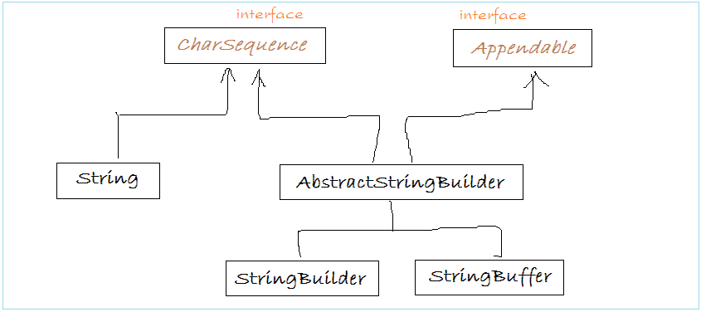
String vs StringBuilder vs StringBuffer

Slide 9
String vs StringBuilder vs StringBuffer
 | String | StringBuilder | StringBuffer
Storage | String pool | Heap | Heap
Mutability | immutable | mutable | mutable
Specific | Has overloaded operator + | No overloaded operators | No overloaded operators
Purpose | Good for temporary literals and constants | Good frequently changed strings | Good frequently changed strings
Thread safety | Yes | No | Yes
Performance | Fast for literals | Fast | Slow

Slide 10
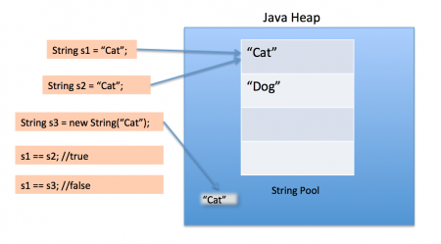
String pool

Slide 11
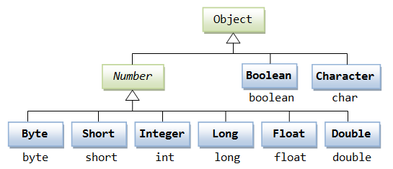
Wrapper Classes

Slide 12

Wrapper Classes
• Overloaded operations
• Pass by value
public static void sum(Integer i) { i = i + new Integer(2); } public static void main(String[] args) { Integer a = 10; sum(a); int b = 10; sum(b); System.out.println("a=" + a); System.out.println("b=" + b); }

Slide 13
Autoboxing and unboxing
//Autoboxing Integer i = 1; //--> Integer i = new Integer(1); System.out.println("2 = " + 2); //--> System.out.println("2 = " + new Integer(2)); //Unboxing i = i + 3; //--> i = new Integer(i.intValue() + 3);
Notes:
Autoboxing is an automatic conversion of a primitive type to his wrapper. For example double in Double, int in Integer, etc. Unboxing - opposite action

Slide 14
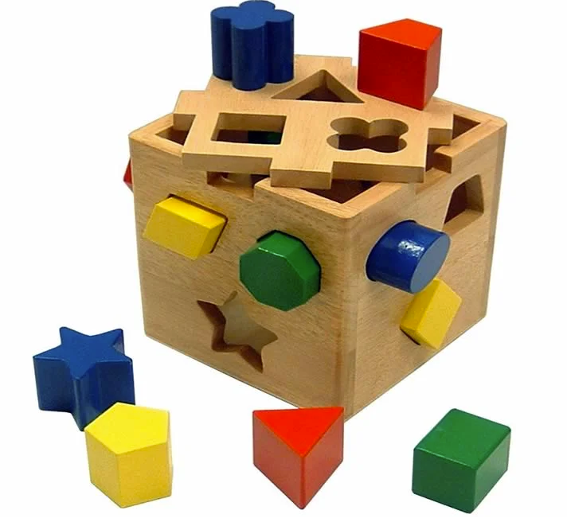
Data types cast

Slide 15
Data types cast
interface Flyable { void fly(); } class Boeing implements Flyable { @Override public void fly() { System.out.println("Boeing"); } } class Airbus implements Flyable { @Override public void fly() { System.out.println("Airbus"); } }
Flyable boeing = new Boeing(); Flyable airbus = new Airbus();
//1 Object castedBoeing = (Object) boeing; ((Flyable) castedBoeing).fly(); // Boeing ((Boeing) castedBoeing).fly(); // Boeing
//2 Object castedAirbus = (Object) airbus; ((Flyable) castedAirbus).fly(); // Airbus ((Boeing) castedAirbus).fly(); // ClassCastException
//3 Object object = new Object(); Boeing notBoeing = (Boeing) object; // ClassCastException

Slide 16
instanceof
Object obj = new Object(); System.out.println(obj instanceof Object); // true String[] strArray = {}; System.out.println(strArray instanceof String[]); // true System.out.println(strArray instanceof Serializable); // true int[] intArray = {1, 2, 3}; System.out.println(intArray instanceof Object); // true System.out.println(intArray[0] instanceof Object); // compile error

Slide 17
instanceof
public void feedAnimal(Animal animal) { if (animal instanceof Cow) { ((Cow) animal).addHay(); } else if (animal instanceof Bird) { ((Bird) animal).addSeed(); } else if (animal instanceof Lion) { ((Lion) animal).addMeat(); } else { throw new RuntimeException("Unsupported animal"); } }

Slide 18
java.lang.Math
Static methods for operations on numbers
public static double sin(double a);
public static double cos(double a);
public static double exp(double a);
public static double sqrt(double a);
public static double pow(double a, double b);
public static int round(float a);
public static double random();
public static int abs(int a);
public static int max(int a, int b);
public static int min(int a, int b);

Slide 19
java.lang.System
System.out.println("Hello World!");
System.currentTimeMillis();
System.exit(1);
System.getProperty("path.separator");
System.gc()
Notes:
Static methods for operations with system.
Contains "useful" fields and methods.
Constructor not available.
All fields and methods are static.
The class provides access to threads in (input stream), out (output stream), err (error output stream), access methods to properties and others

Slide 20
java.lang.Runtime
Process process = Runtime.getRuntime().exec(/*...*/);
/* System::exit */ public static void exit(int status) { Runtime.getRuntime().exit(status); }
Notes:
Allows you to access the "environment" and run independent processes.
At run time, there is only one instance of the Runtime in the JVM.
The constructor of this class is not available, but (in contrast to System) there are non-static methods.

Slide 21

Optional

Slide 22
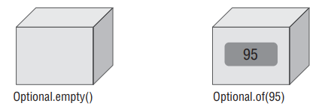
java.lang.Optional
Optional - “we don’t know” or “not applicable”
created using a factory
a clear way to express that null might be a special value
Notes:
A container object which may or may not contain a non-null value.
Additional methods that depend on the presence or absence of a contained value are provided

Slide 23
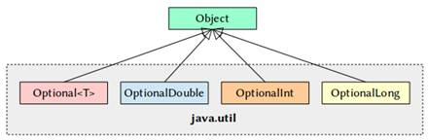
Optional

Slide 24

Optional creation
Optional.of(…)
Optional.ofNullable(…)
Optional.empty()
From stream terminal operation

Slide 25
Optional is immutable
Optional<Integer> integer = Optional.of(1); integer.map(o -> o * 2); System.out.println(integer); // Optional[1]

Slide 26
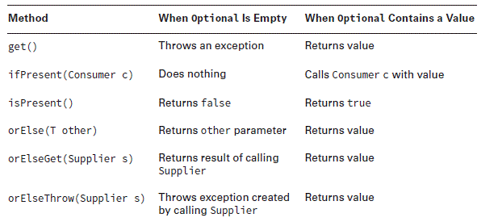
Optional methods

Slide 27
Optional usage
static Optional<Double> average(int... scores) { if (scores.length == 0) { return Optional.empty(); } int sum = 0; for (int score : scores) { sum += score; } return Optional.of((double) sum / scores.length); }
Optional<Double> average = average();
print(average); // Optional.empty print(average.get()); // throws NoSuchElementException
print(average.orElse(null)); // null
print(average.isPresent() ? average.get() : null); // null print(average(1, 2)); // Optional[1.5] print(average(1, 2).get()); // 1.5 average().ifPresent(System.out::println); // nothing printed average(1,2).ifPresent(System.out::println); // 1.5

Slide 28
Optional vs regular if
Person person = getDefaultPerson(); if (person != null) { PersonAddress personAddress = person.getAddress(); if (personAddress != null) { PersonAddressStreet street = personAddress.getStreet(); if(street != null) { streetName = street.getStreetName(); } else { streetName = "EMPTY"; } } }
String streetName = Optional.ofNullable(person)
.flatMap(Person::getAddress) .flatMap(PersonAddress::getStreet) .map(PersonAddressStreet::getStreetName) .orElse("EMPTY");

Slide 29

Optional usage
Notes:
Use optional for local variables
Use optional in return statement
Do not use optional for class fields
Do not use optional for method/constructor arguments

Slide 30
Literature
Read AGAIN and follow Java Code Conventions
Learn how hashCode, equals, toString are implemented in java.lang.String, java.lang.Integer and java.util.ArrayList.
Look for methods in Math, System, Runtime, Optional classes
Read doc
Numbers and Strings
The Platform Environment

Slide 31
Homework Task 1
Implement the program for change the input string register. Read string from command line argument during program srartup and do:
When the first symbol of input is in upper case, then translate entire string to the lower case;
When the first symbol of input is in lower case, then translate entire string to the upper case;
When first symbol is not an English letter – return input as is;
All tests in StringUtilsTest should pass successfully.

Slide 32
Homework Task 2
Implement a performance tests of the concatenation methods. Find the most efficient data structure:
String::+
String::concat
StringBuffer::append
StringBuilder::append
To measure runtime, use System.nanoTime()
All tests in StringRepeaterTest should pass successfully

Slide 33
Homework Task 3
Implement program to print out user PC info:
Number of CPU cores;
Free RAM (for all system, but not only JVM) in megabytes;
Total RAM (for all system, but not only JVM) in megabytes;
Hard drive memory info free/total for all drives in megabytes;
Java version;
User name;
User home directory;
OS Name.
All tests in SystemInfoProviderTest should pass successfully

Slide 34
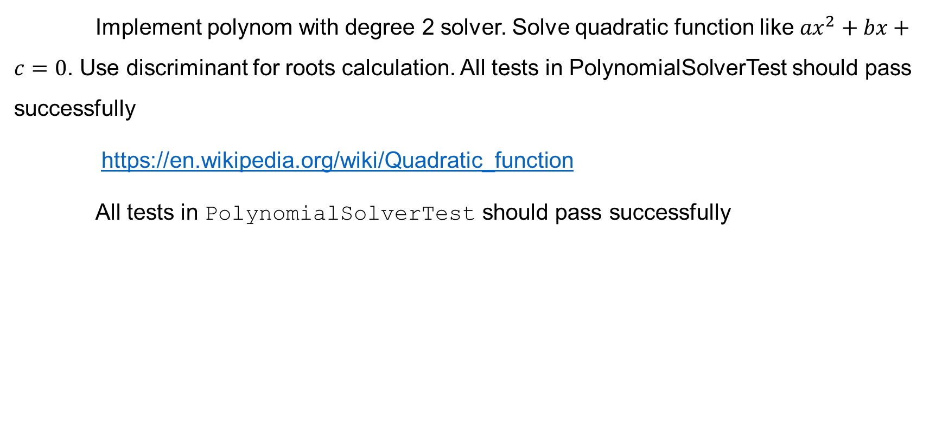
Homework Task 4
Implement polynom with degree 2 solver. Solve quadratic function like ${ax}^{2}+bx+c=0$. Use discriminant for roots calculation. All tests in PolynomialSolverTest should pass successfully
https://en.wikipedia.org/wiki/Quadratic_function
All tests in PolynomialSolverTest should pass successfully

Slide 35
Q&A

